Slide 1
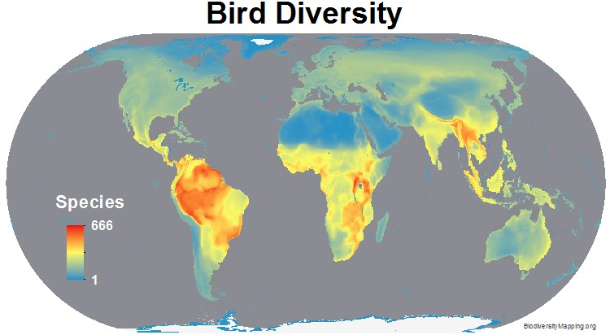
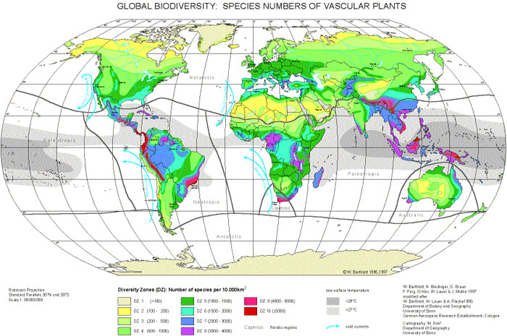
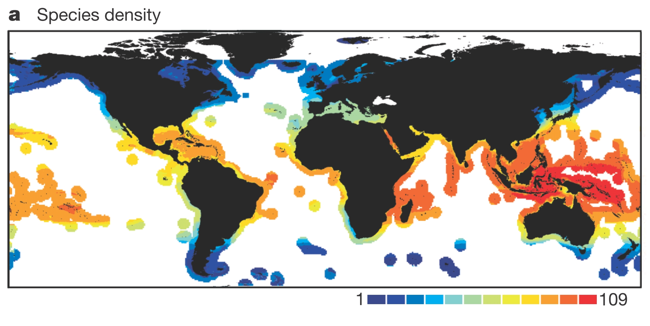
Bird Diversity
Vascular Plants
Marine Fishes
Global Diversity Patterns:
-Latitude (but why?)
-Energy
-Evolution/Historic Biogeography
-Habitat Heterogeneity
-Human Influence
-….. And many more

Slide 2
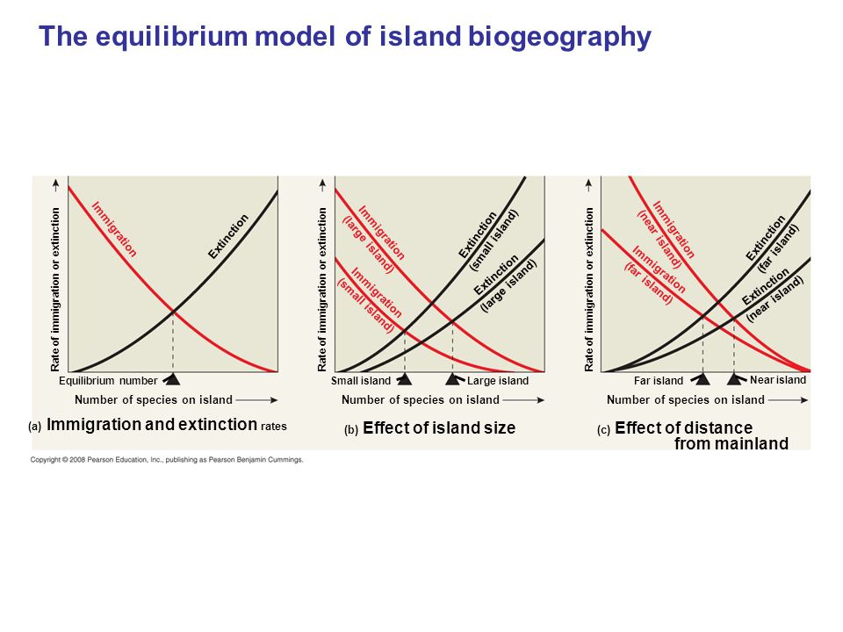
A Simple Model: Island Biogeography

Slide 3
Near Mainland
Far from Mainland
MacArthur and Wilson 1963

Slide 4
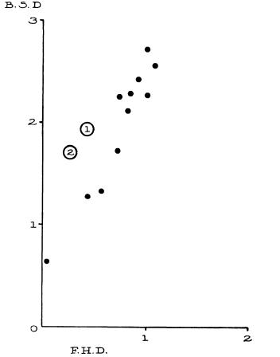
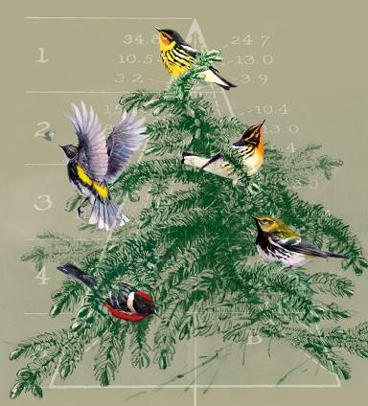
Ecological Niches as the Basis for Coexistence/Diversity
Bird Diversity
Limiting Similarity (Hutchinsonian ratios)
--Hutchinson 1959
Competition and coexistence
--MacArthur (1958)
Foliage Height Diversity
MacArthur and MacArthur 1961

Slide 5
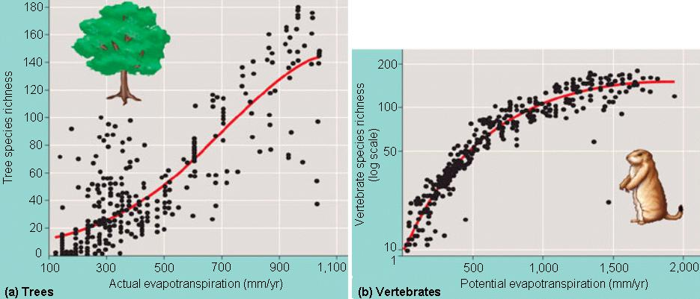
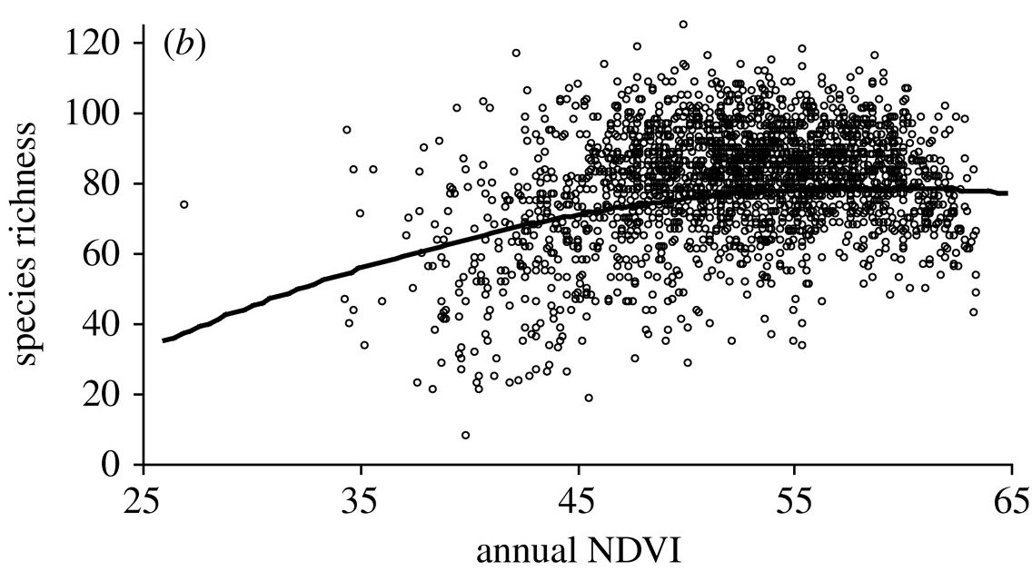
Species Energy Relationships

Slide 6
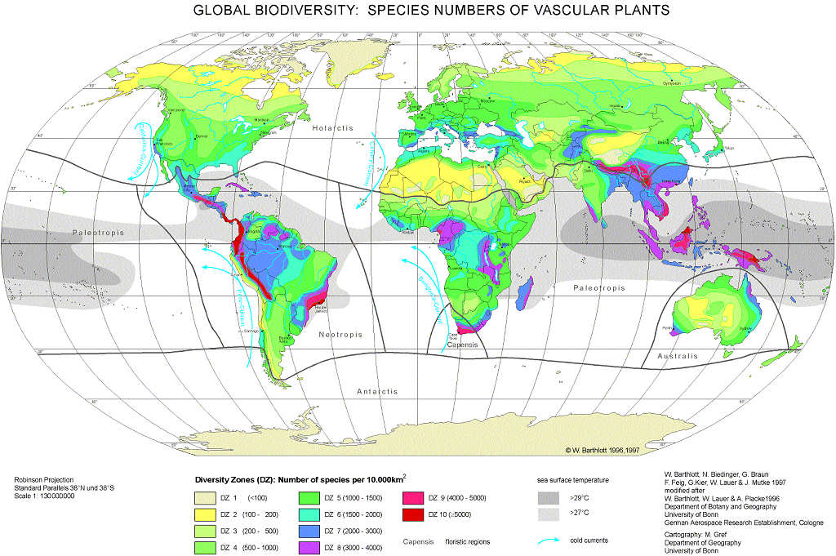
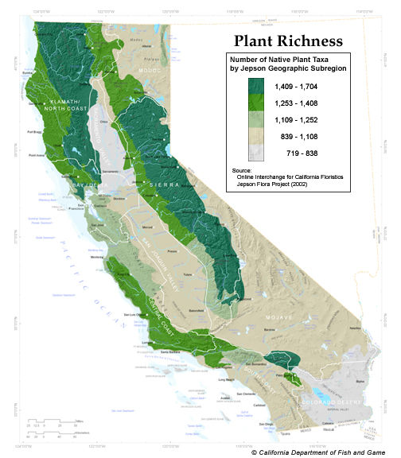
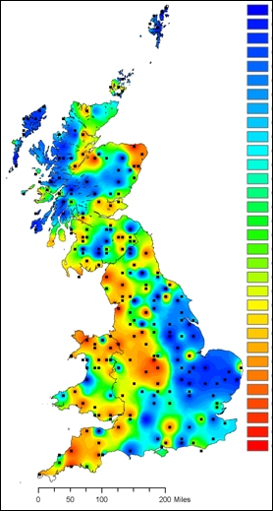
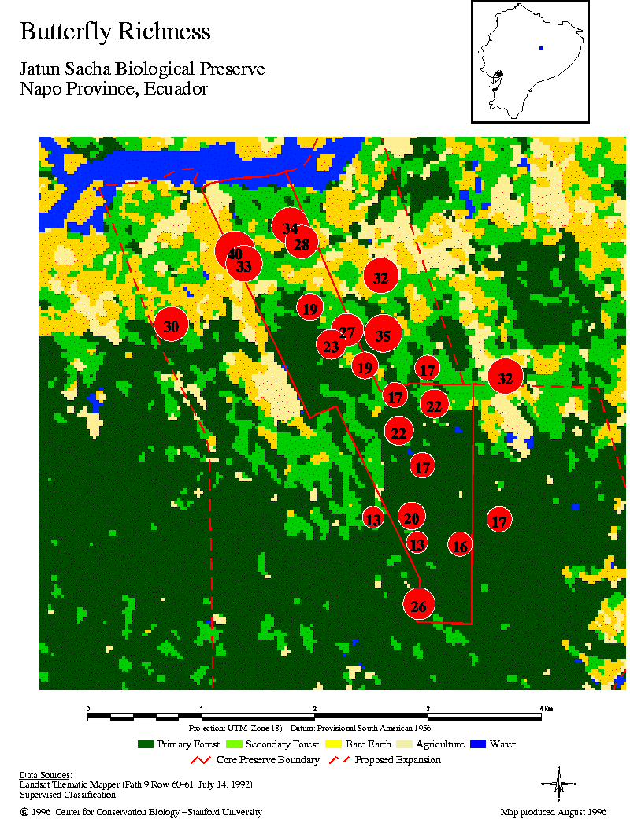
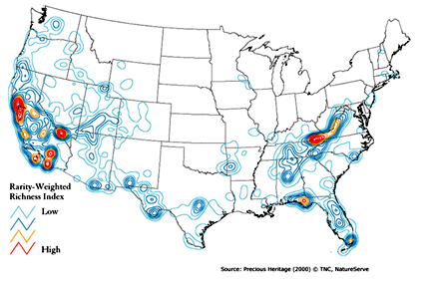
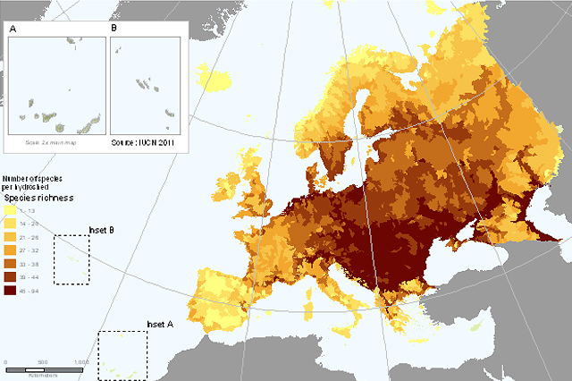
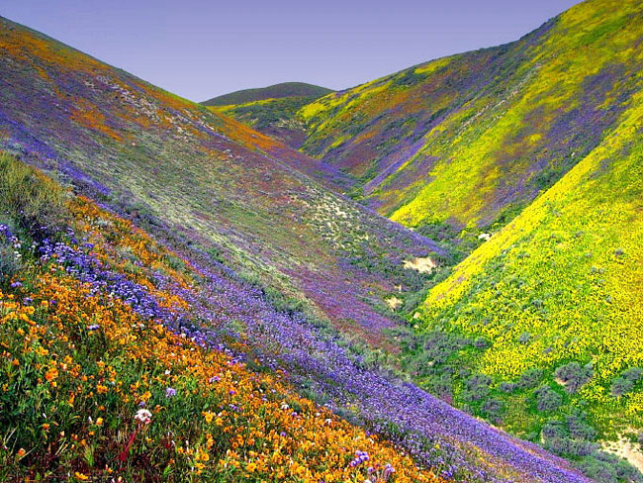
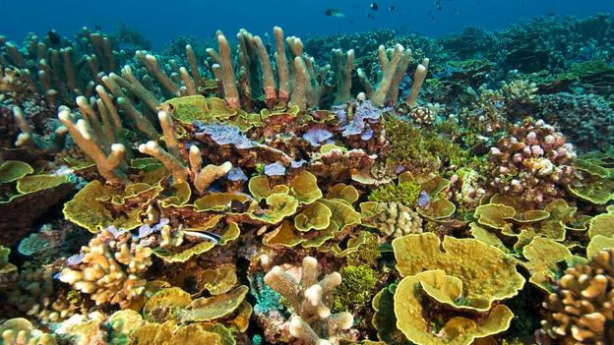
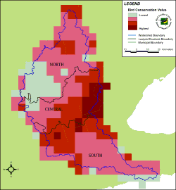

Slide 8
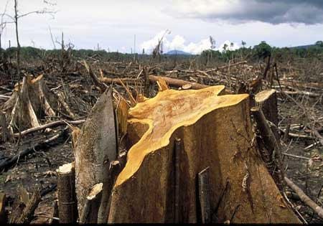
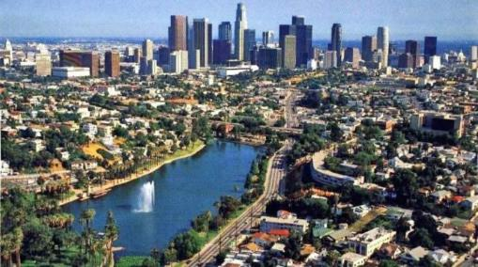
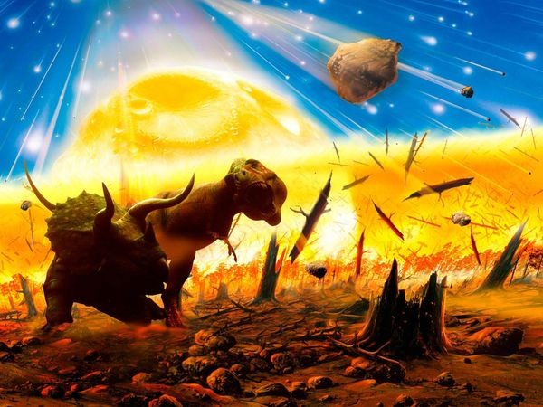
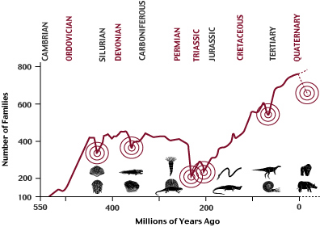
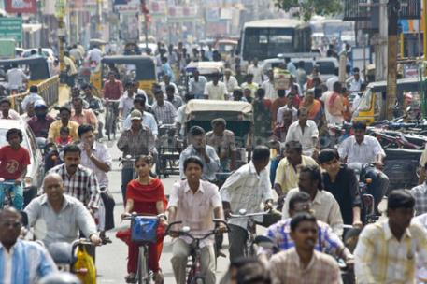
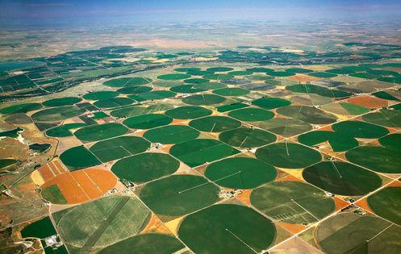
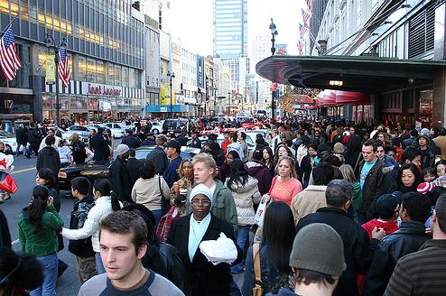

Slide 9
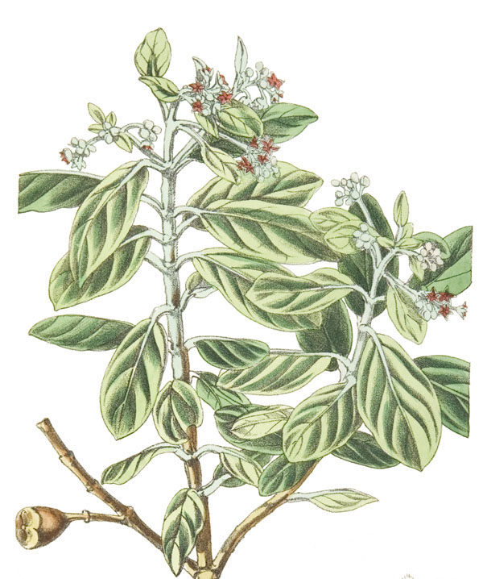
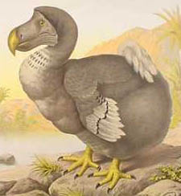
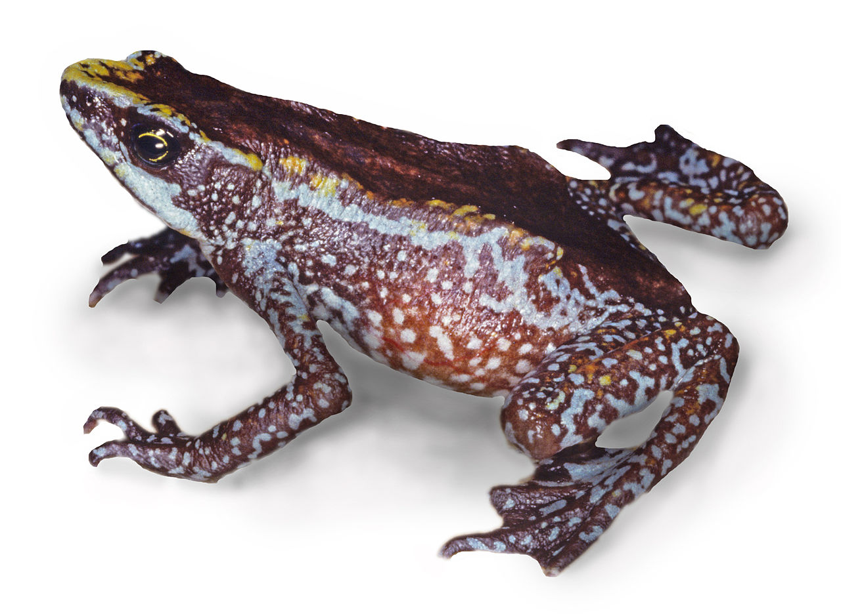
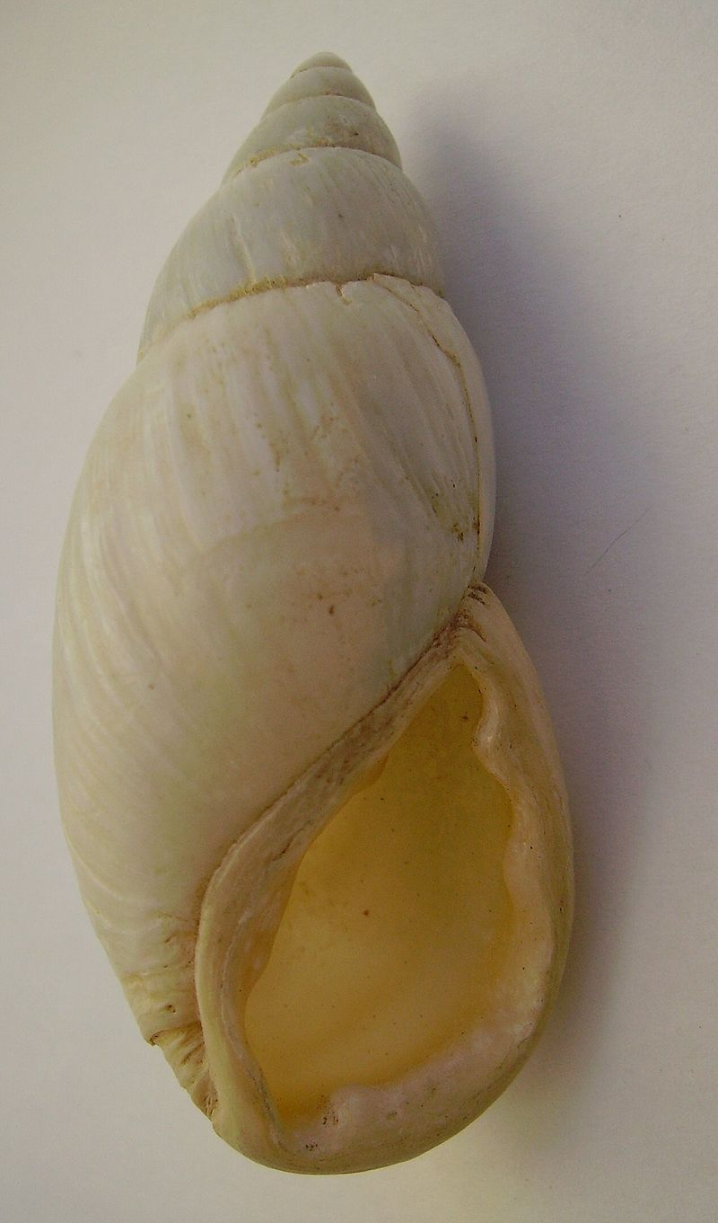
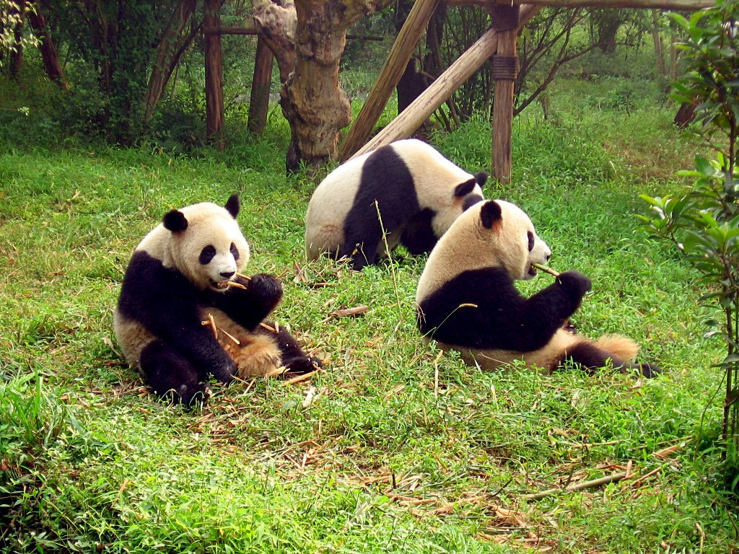
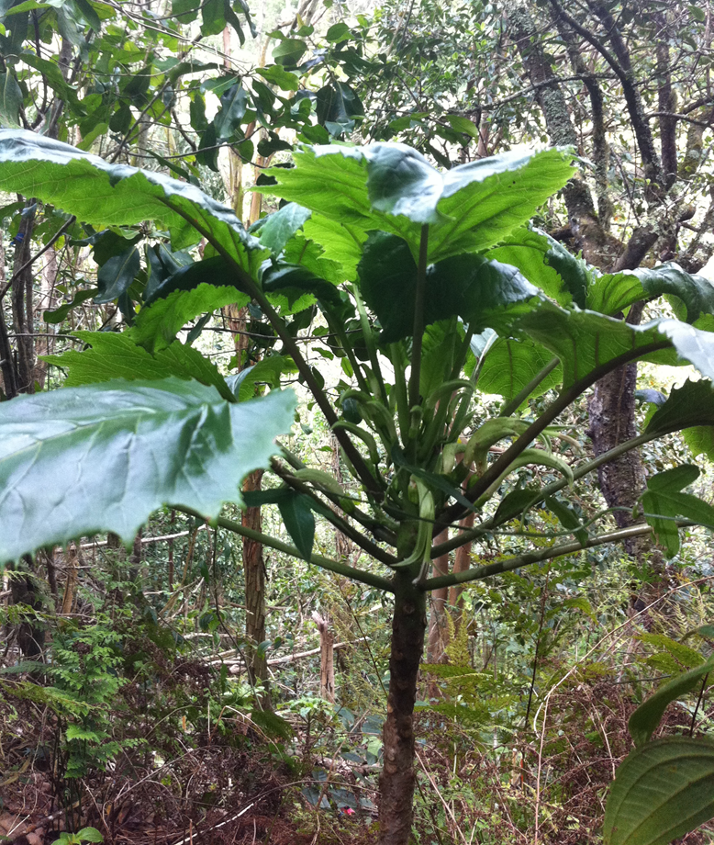
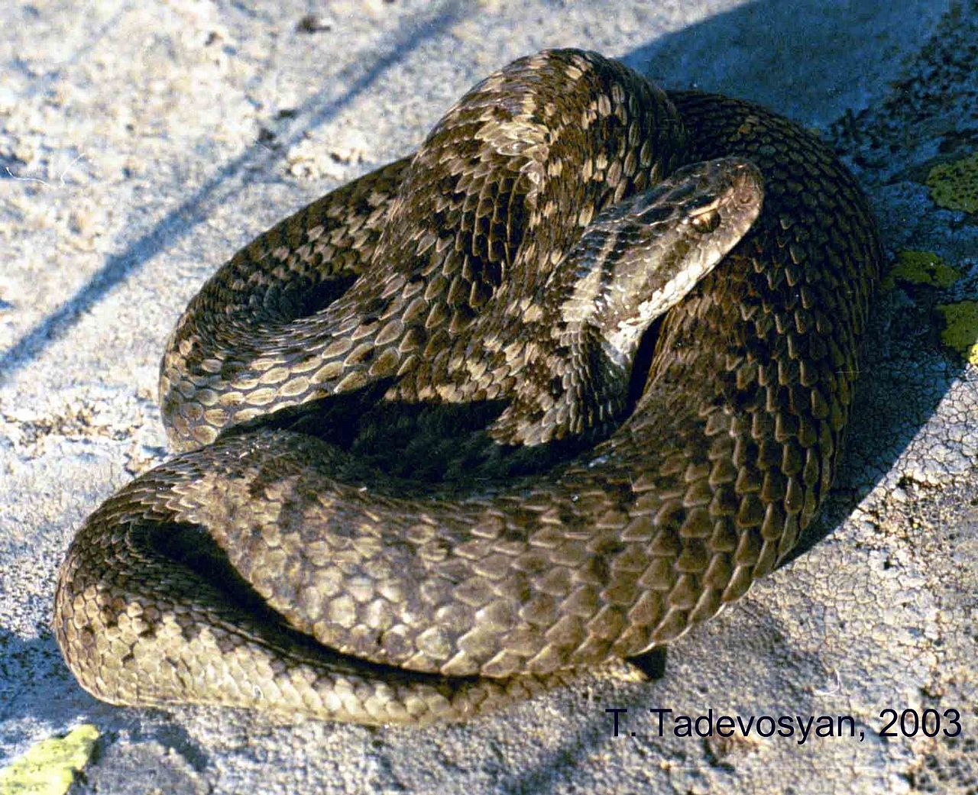
Sixth Mass Extinction?
Public Domain, https://commons.wikimedia.org/w/index.php?curid=352902
By Brian Gratwicke https://commons.wikimedia.org/w/index.php?curid=33287935
Public Domain, https://commons.wikimedia.org/w/index.php?curid=1582404
By John Charles Meliss - Public Domain, https://commons.wikimedia.org/w/index.php?curid=2587688
By Tigran Tadevosyan - https://commons.wikimedia.org/w/index.php?curid=19441383
CC BY-SA 2.5 es, https://commons.wikimedia.org/w/index.php?curid=531560
By Tiffany Knight (used with permission)

Slide 10
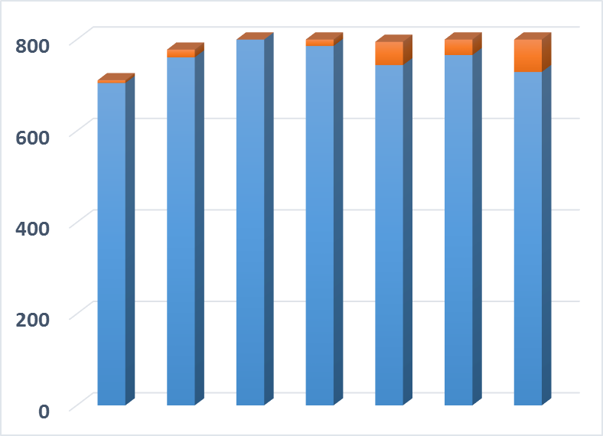
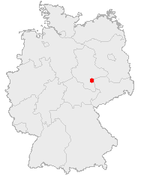
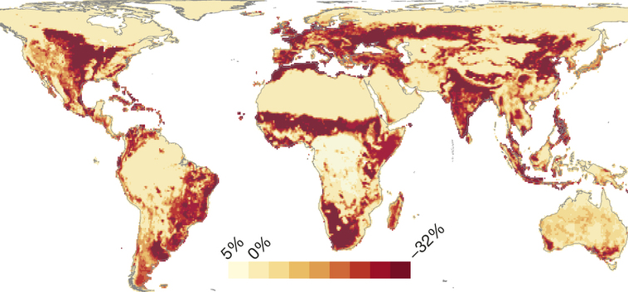
Is there biodiversity loss at smaller scales??
Number of Species
Public Domain, https://commons.wikimedia.org/w/index.php?curid=362363
~1700
1850
1950
~Today
Year
Data from: Knapp, S., et al. 2016. Increasing species richness but decreasing phylogenetic richness and divergence over a 320‐year period of urbanization. Journal of Applied Ecology. doi:10.1111/1365-2664.12826
Reprinted by permission from Macmillan Publishers Ltd: Newbold, T., et al. 2015. Global effects of land use on local terrestrial biodiversity. Nature, 520: 45-50.

Slide 11
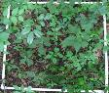
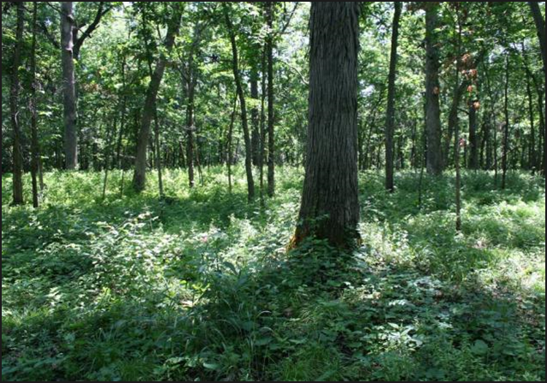
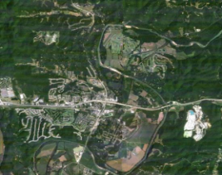
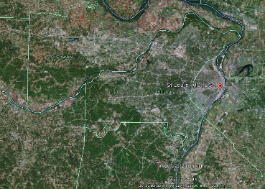
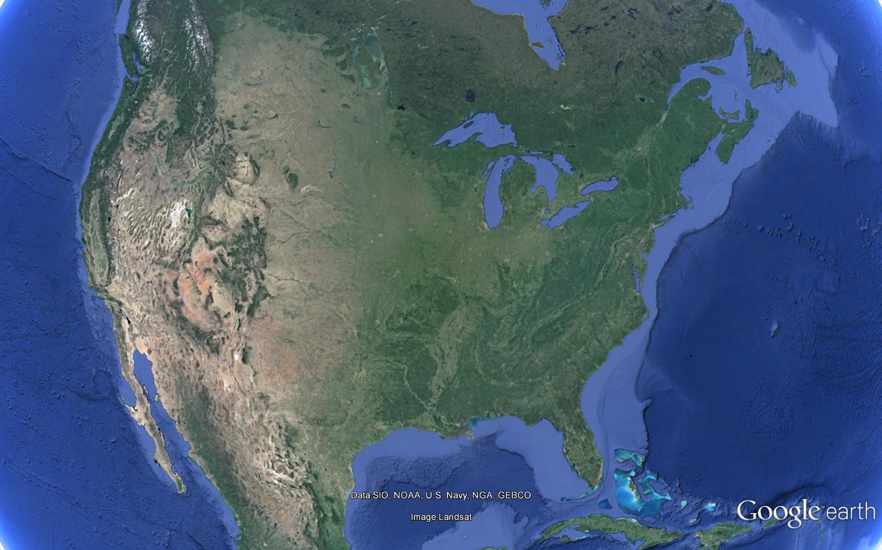
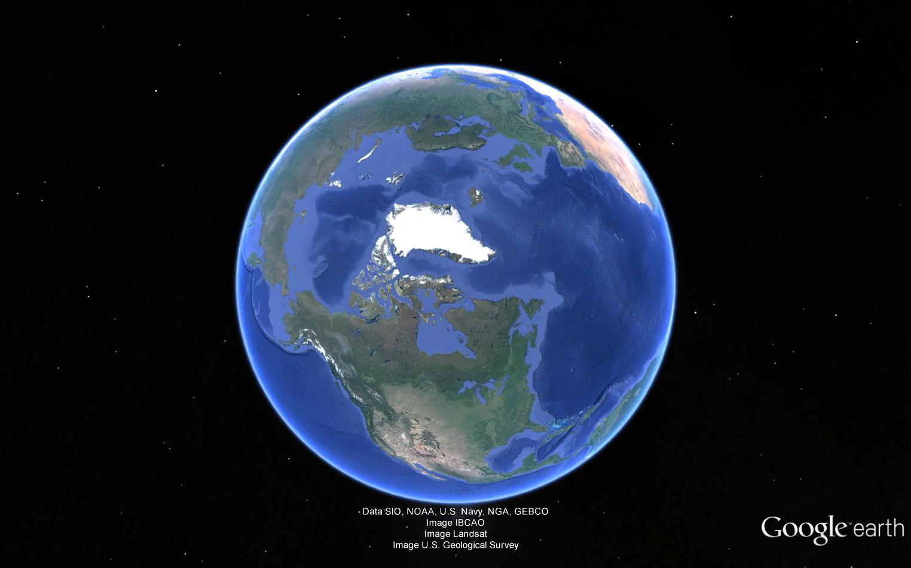
Biodiversity Scaling

Slide 13
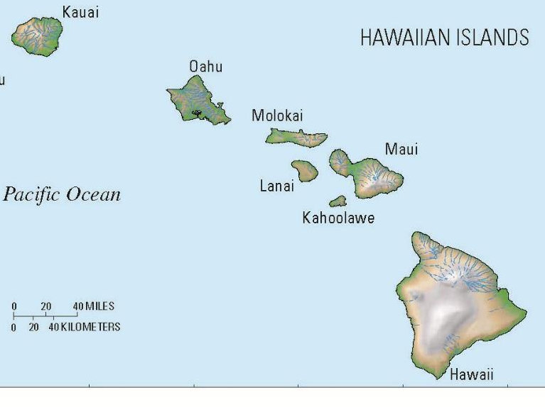
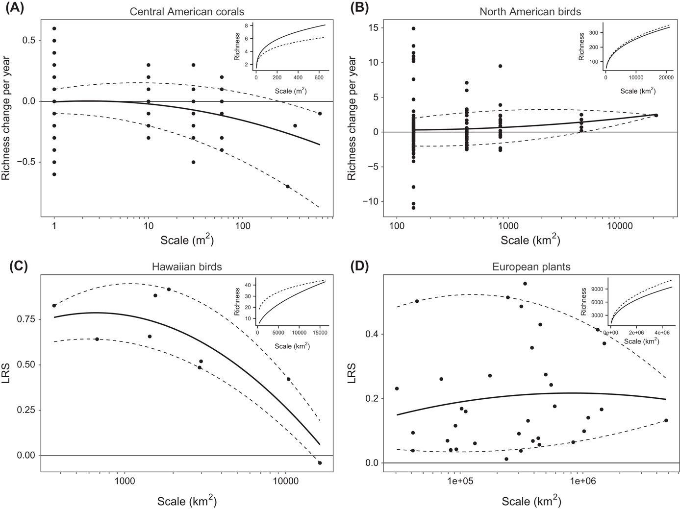
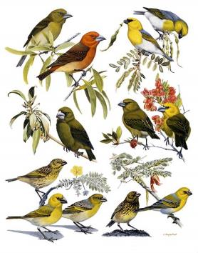

Slide 14
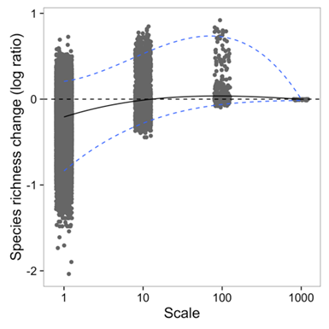
Biodiversity change—Scale matters
Theoretical Expectations
Meta-analytical results (plants only)

Slide 15
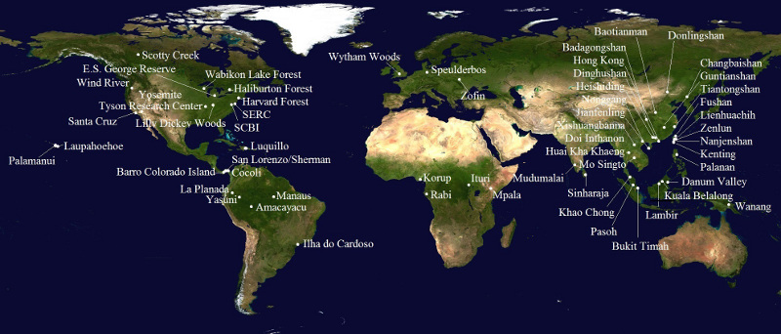
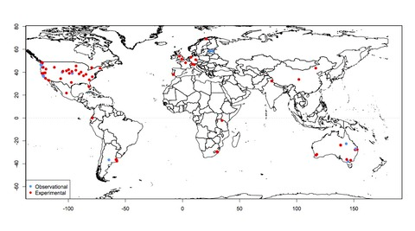
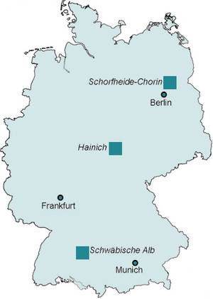
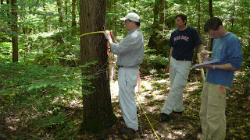
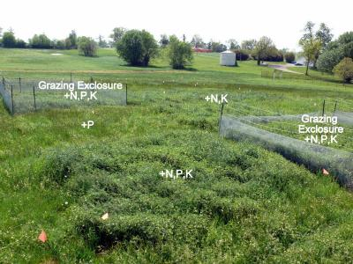

Aren’t consistent sampling schemes enough?
Unfortunately, no….
CTFS-SGIEO Forest Plots
NutNet Forest Plots

Slide 16
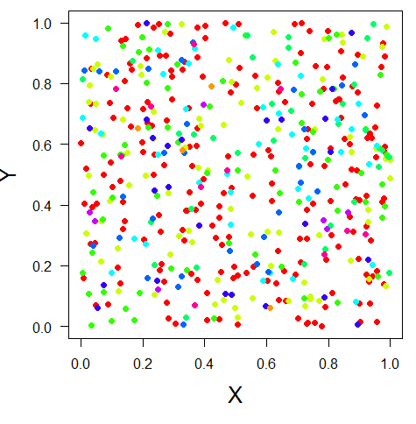
Any measure of diversity only captures part of the picture
α, richness, evenness, diversity entropy
β, similarity, distance decay
γ, SAR, EAR, etc
The only way we can ‘control’ this is when we make unrealistic assumptions
-i.e., a community has an ‘end’ and an ‘asymptote’

Slide 17
Before we can achieve synthesis…we need to use the right concepts and ask the right questions
The Problem:
Sampling and Scale
Sampling and species-pool dependent effect sizes render traditional approaches (ANOVA, Meta-analysis) ambiguous
The Solution: ‘
‘Biodiversity’ metrics are simply summary variables driven by 4 primary underlying patterns of species abundance and distribution
Total abundance (Rarefaction)
Relative abundance (SAD)
Spatial aggregation (clumpiness)
The richness of the species pool (S)
Throw out the concept of biodiversity as a single value in analysis and focus explicitly on its scaling properties

Slide 18



Species accumulation with scale will be non-parallel when the abundance and spatial distribution of species is altered—altering N, SAD, or aggregation
The density of individuals (N)
The relative abundance of individuals (SAD)
The spatial aggregation (clumping) among
individuals

Slide 19
A Resolution? Sampling and Scale
(more/fewer individuals)
Degraded Community
Pristine Community
Small Effect
Large effect
10
Species Richness
8
6
4
2
0
0 30 60 90 120 150 180
Area Sampled
Chase and Knight 2013 Ecology Letters

Slide 20






Scale-dependence of invasive species impacts
2.0
R²=0.995, P<0.001
R²=0.978, P=0.001
1.5
Log(Species Richness)
1.0
Uninvaded
Invaded
0.5
0
1
2
3
Log(Area)

Slide 21




What if drivers are not neutral?
-More (or less) than ‘more individuals’
Some Examples…
Goat Exclosure
N Fertilizer
Increased CO₂/acidification

Slide 22


Habitat Loss Often Disproportionately Reduces Rare Species
More Even Community
Less Even Community
Small Effect
Large effect
10
Species Richness
8
6
4
2
0
Chase and Knight 2013
Ecology Letters
0 30 60 90 120 150 180
Area Sampled

Slide 23




Effects for ‘island size’

Slide 24

Horvath et al. 2019

Slide 25

Horvath et al. 2019

Slide 26
Altering N, SAD, or aggregation----or S
Species Richness
Species Richness
Change SAD
Change S
Change SAD
No Change S
A or N
A or N
S differs for different reasons
Species Richness
Species Richness
No Change SAD
Change S
How can this happen?
A or N
A or N

Slide 27
What causes accumulation curves to cross?
How can you detect this?
How often does it happen?
Graham and Blake 2001

Slide 28

Chase et al. 2018

Slide 29


..but we already have a way to deal with scale…β-diversity
α β = γ
β = γ/α
γ-diversity (21)
10
3
α-diversity
= 21 / 7
= 3
4
11
5
9
α-diversity
β-diversity is a scalar from local (α) to regional (γ)

Slide 30
Distance-decay….
Nekola and White 1999

Slide 31



Slide 32
γ-diversity
β-diversity
Diversity
α-diversity
Local Regional
Spatial Scale
Linearization of an inherently non-linear pattern
Shape determined by several distinct components that underlie SAC
Critically grain and extent dependent

Slide 33
Sample Grain and Extent also drive β-diversity
Larger grain/extent
α-diversity
α-diversity
γ-diversity
γ-diversity
β
β
Number of Species
β
β
Area sampled

Slide 34



package mobsim

Slide 35


An R package: Measurements of Biodiversity (MoB)
Individuals
Difference controlling for Aggregation
Difference Controlling for N
Observed difference in S

